Slide 1
Chapter 7

Slide 2
Files modified
Graphbook/src/server/index.js
Src/server/services/graphql/schema.js
Src/client/apollo/mutations/uploadAvatar.js
Src/server/services/graphql/resolvers.js
Src/client/apollo/index.js
Src/client/apollo/mutations/uploadAvatar.js
Src/client/apollo/fragments/userAttributes.js
Src/client/components/avatarModel.js
Src/client/components/bar/user.js

Slide 3
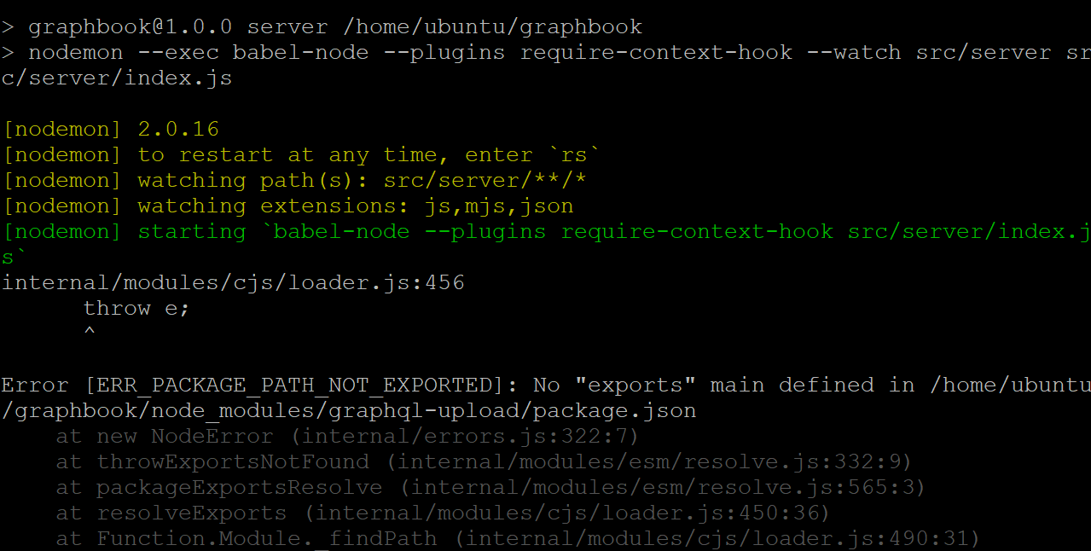

Slide 4
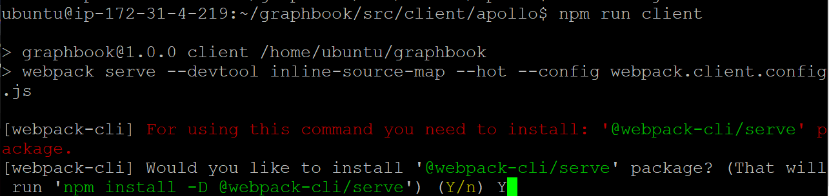

Slide 5
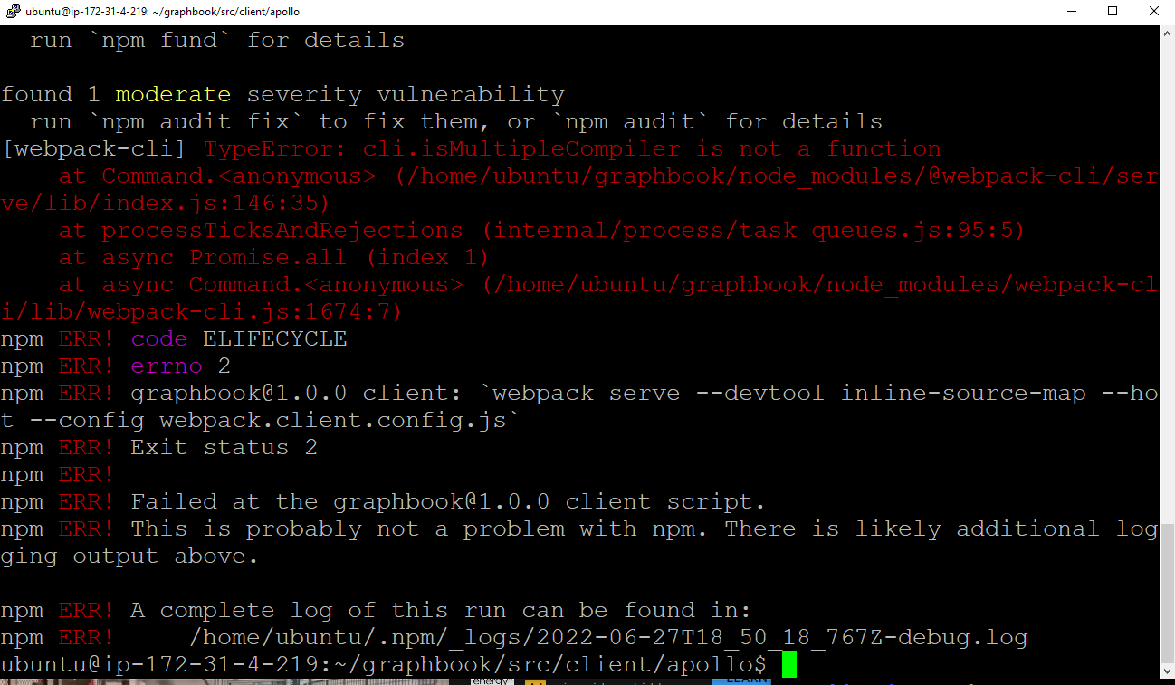

Slide 7
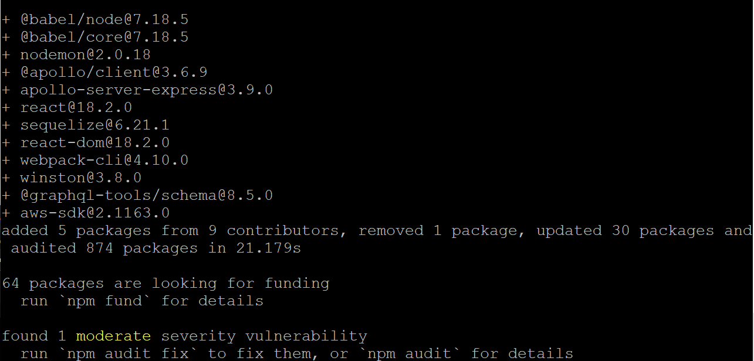

Slide 8
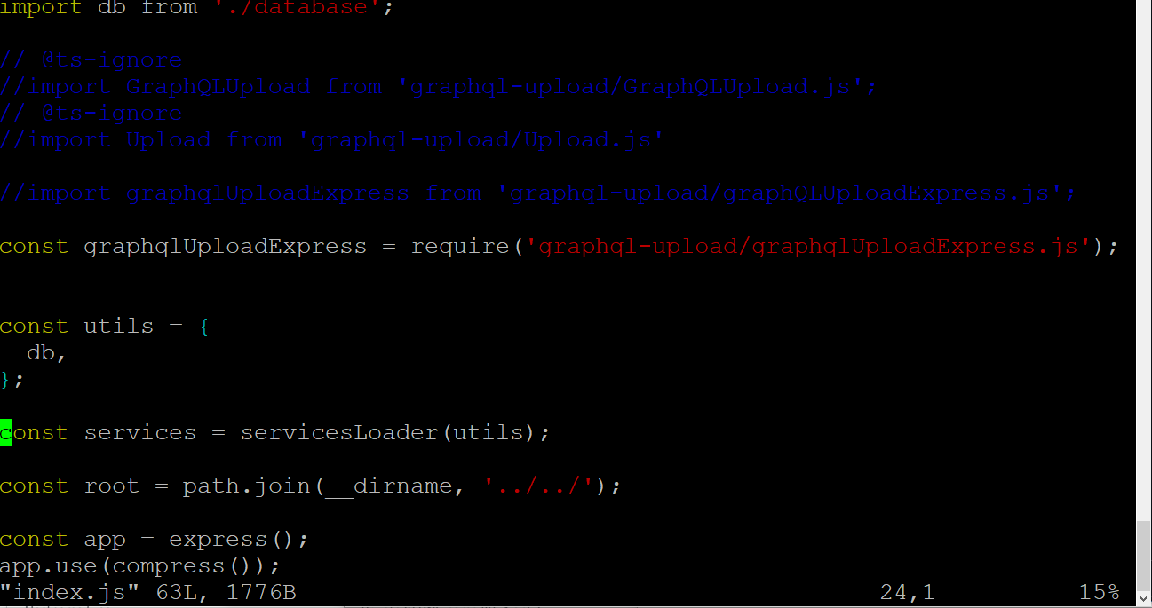
The fix: three files
ubuntu@ip-172-31-4-219:~/graphbook/src/server$ vi index.js

Slide 9
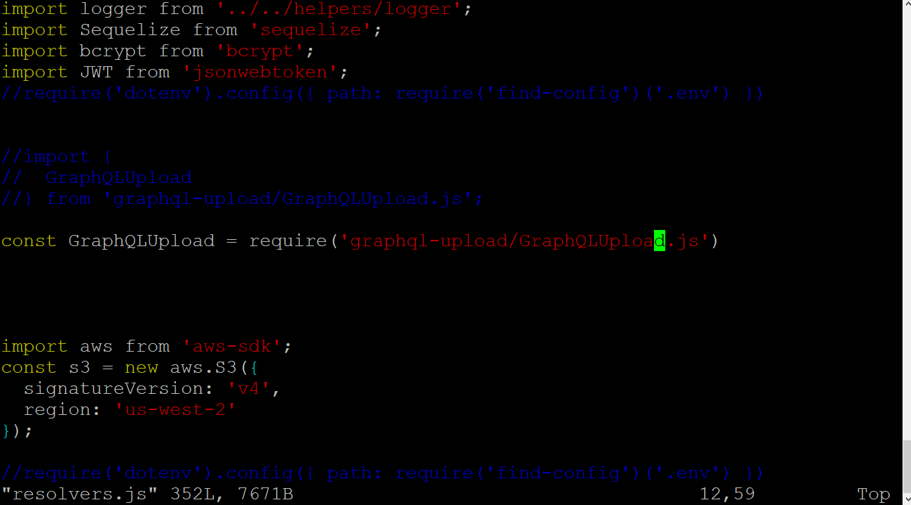
Src/server/services/graphql/resolvers.js is the file to change (only one single line for the GraphQLUpload

Slide 10
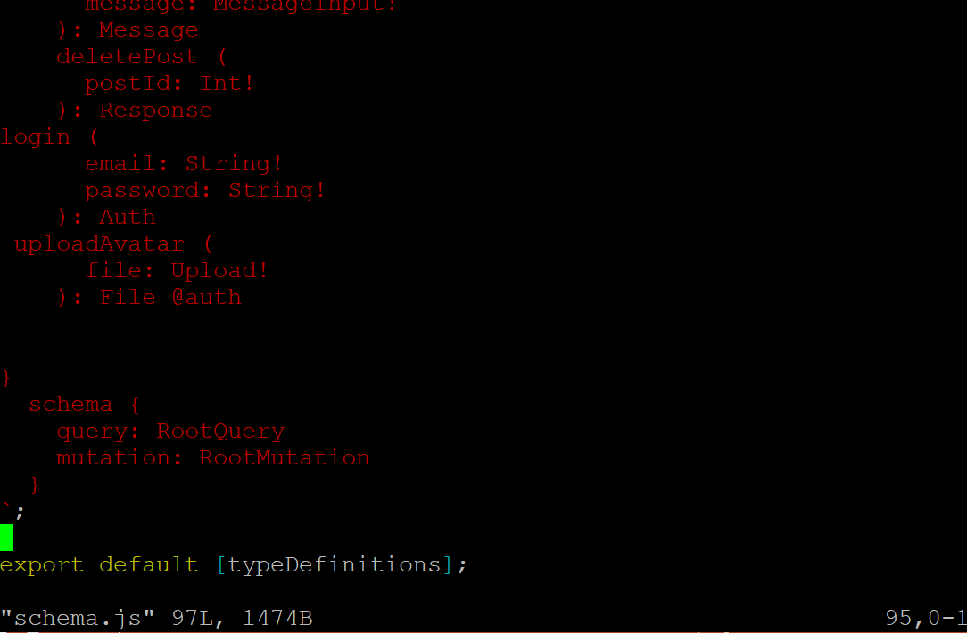
Src/server/services/graphql/schema.js

Slide 11
npm update && npm audit fix --force

